Slide 1


Slide 2

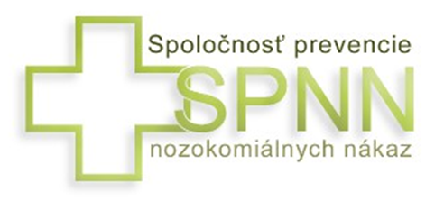
Welcome from the
Society for Nosocomial
Infections Prevention
Established 2005 (member of EFHSS since 2004)
Chair: Assoc. Prof. Rasti Maďar, MD, PhD.
Experts from both Czech and Slovak Republics
6 sections (disinfection, sterilization, surveillance
of NI, preventive nursing, preventive medical
procedures, quality of health care)

Slide 3
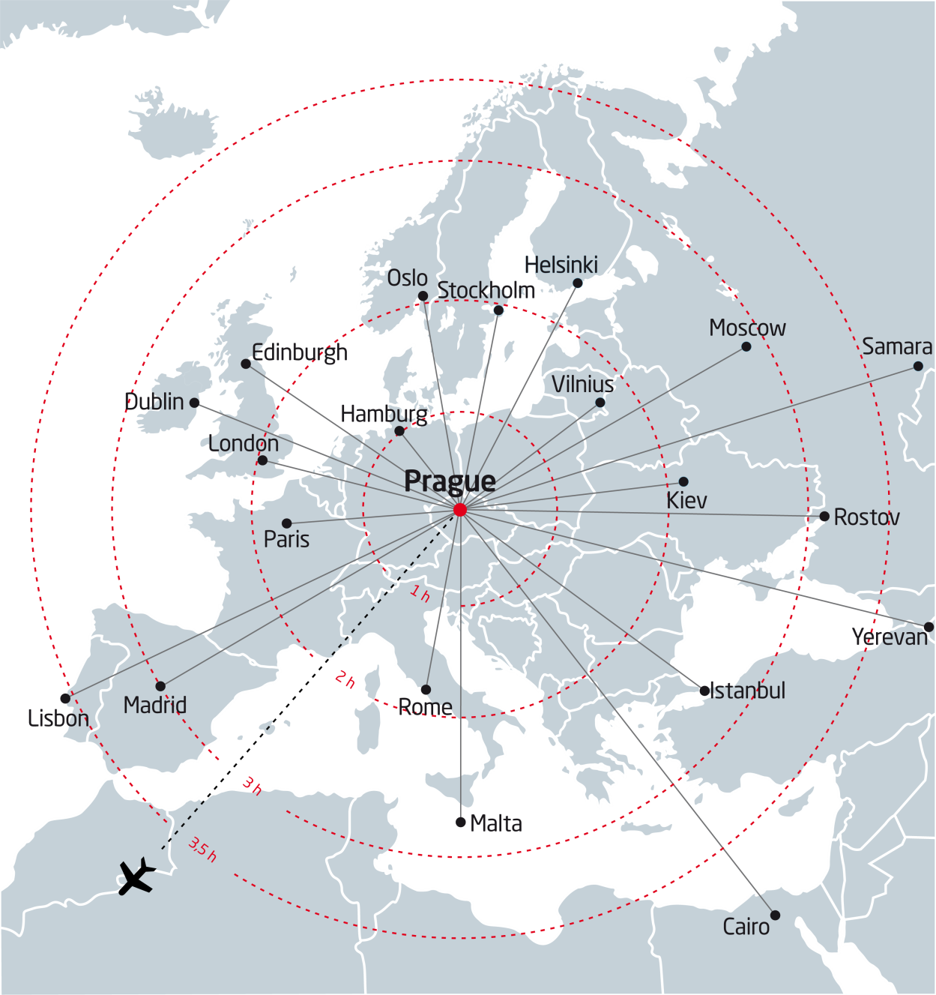
40 countries within 3 hours
•
Frankfurt
Notes:
From most European destinations, it takes only a couple of minutes by plane to Prague. For those coming from overseas and distanced countries, Prague is an ideal place to start or end their trip around Europe. Look at the map and see how the major hubs are close to Prague: Frankfurt (40 min), Paris (1 ½ hour) or London (less than 2 hours). Delegates from as many as 40 countries will reach Prague by air within 3 hours.

Slide 4

Easy airline connection
Prague
Just one stopover from all other continents e.g. via:
Paris (Air France)
London (British Airways)
Frankfurt (Lufthansa)
Istanbul (Turkish Airlines)
Dubai (Emirates)
Abu Dhabi (Etihad)
Many others (Finnair, SAS, Aeroflot, US …)

Slide 5
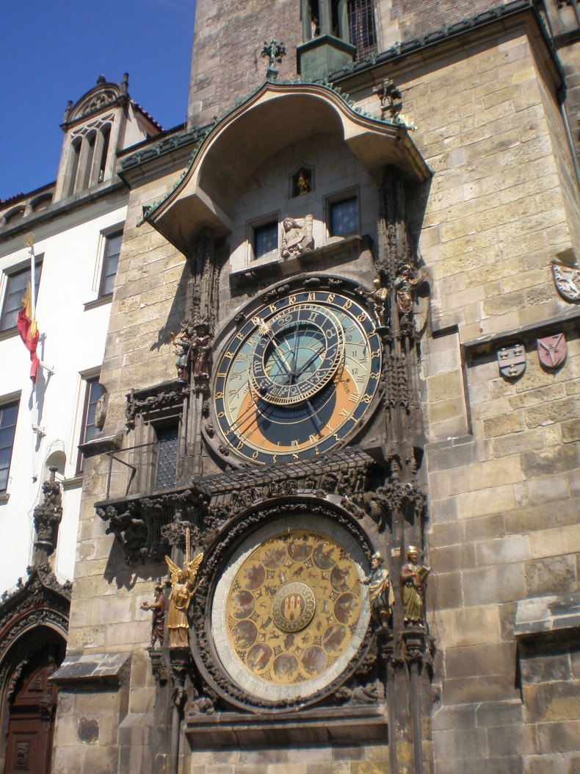
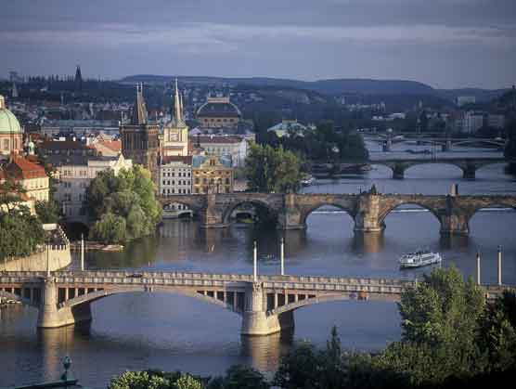
Prague – beautiful, historical, and safe place in the heart of Europe

Slide 6
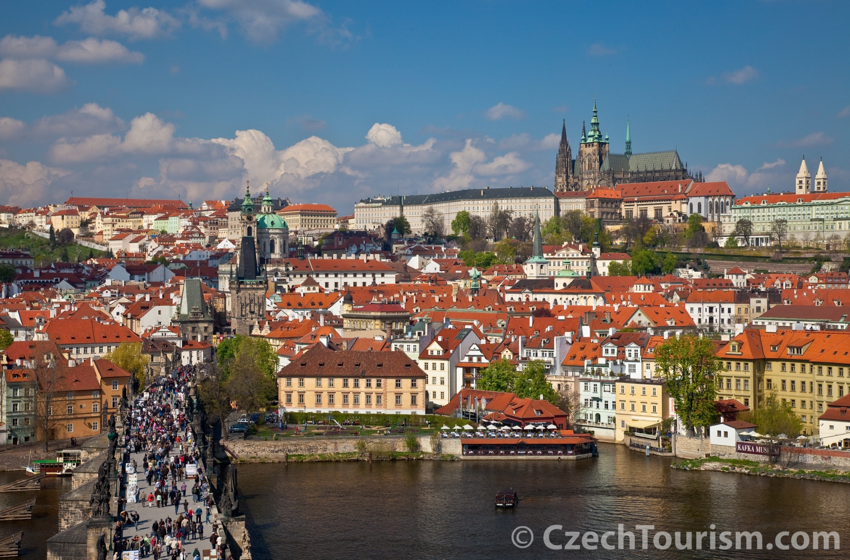
Prague Castle and Lesser Town

Slide 7
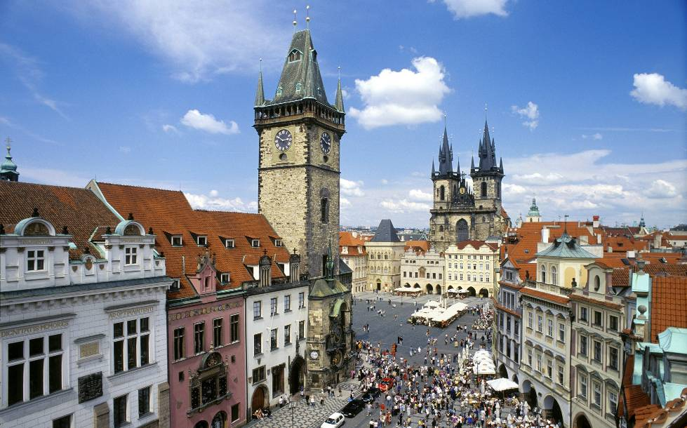
Old Town Square

Slide 8
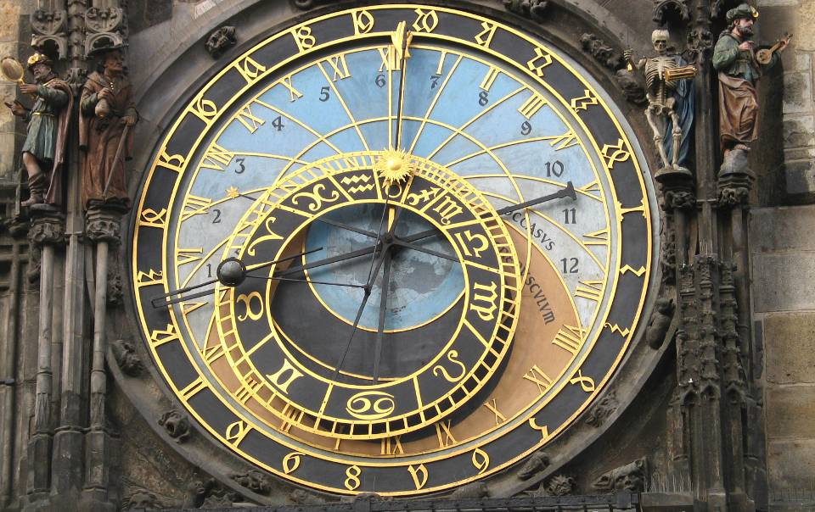
Astronomical Clock

Slide 9
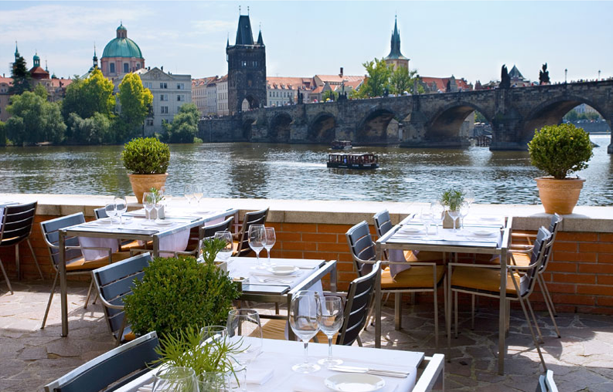
Prague´s Restaurants

Slide 10
Clarion Congress Hotel Prague – prestigeous awards
Best Clarion Hotel in Central Europe in 2008 and 2012
Best Clarion Hotel in Europe in 2009
Winner of the Czech Hotels Awards 2012 and 2013 (congress hotels)
Booking.com Award in 2012
Tripadvisor Certificate of Excellence in 2013

Slide 11
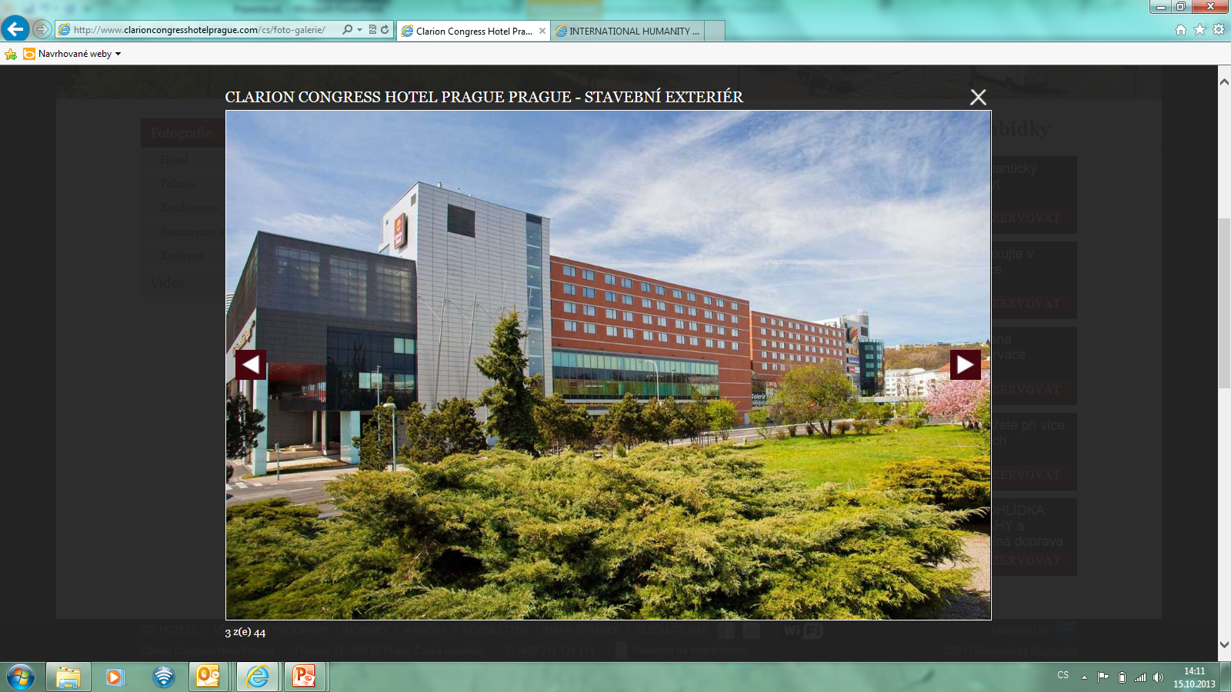
4,000 m² of congress ground divided into 18 lounges and halls with the seating capacity up to 2,500 participants
559 rooms
Free Wi-Fi in all places

Slide 12
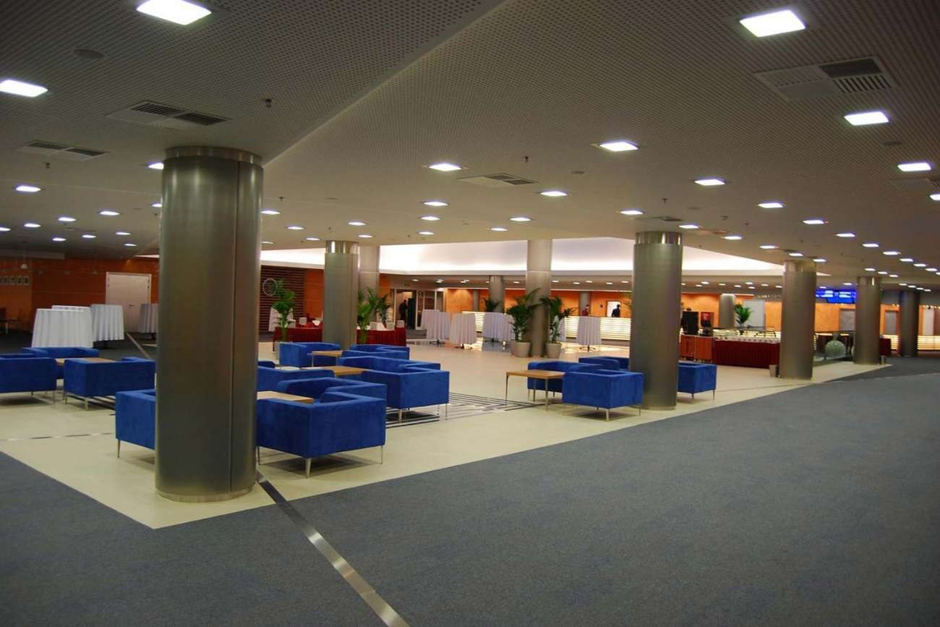

Slide 13
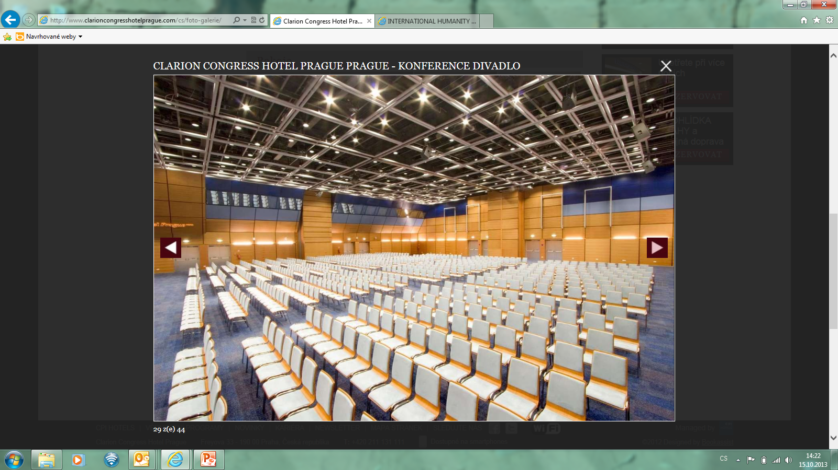

Slide 14
Attached Shopping Mall – Galerie Fénix
http://www.galeriefenix.eu/
80 shops at 3 levels – shopping, relax, entertainment, post office, pharmacy, food court, 600 parking places
Directly at the „B“ line Metro Station only 10 minutes from the historical city centre - free public transport pass for congress delegates

Slide 15
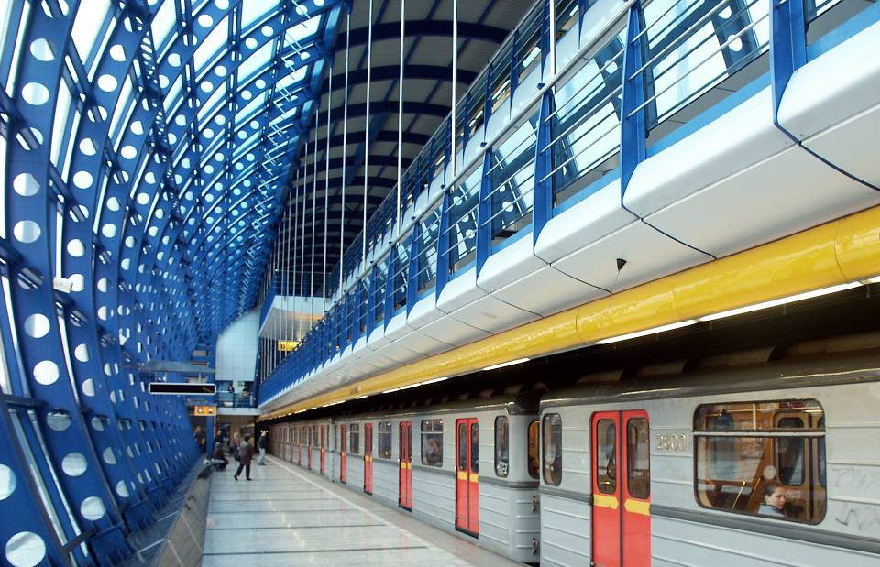
Prague´s Metro

Slide 16
List of selected hotels
 | Travelling time to Congress venue | Public transportation
êêêêê
Radisson Blu Alcron | 15 minutes | 5 min walk + 7 stops by metro
êêêê
Clarion Congress Hotel Prague | Congress venue | Congress venue
Jurys Inn | 10 minutes | 1 min walk + 5 stops by metro
Olympik | 10 minutes | 5 min walk + 3 stops by metro
êêê
Arlington | 5 minutes | 2 min walk + 2 stops by tram
Axa | 10 minutes | 2 min walk + 5 stops by metro
Carol | 5 minutes | 2 min walk + 2 stops by tram
Esprit | 5 minutes | 2 min walk + 2 stops by tram
Vysočanský pivovar | 5 minutes | 5 min by walk
êê
Vysočanský pivovar | 5 minutes | 5 min by walk

Slide 17
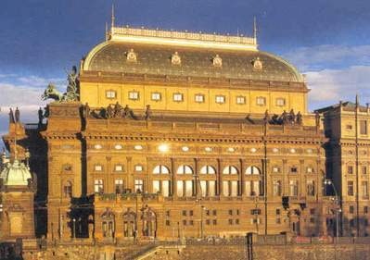
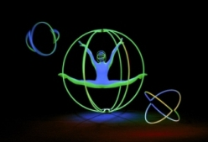


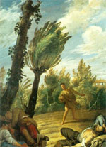
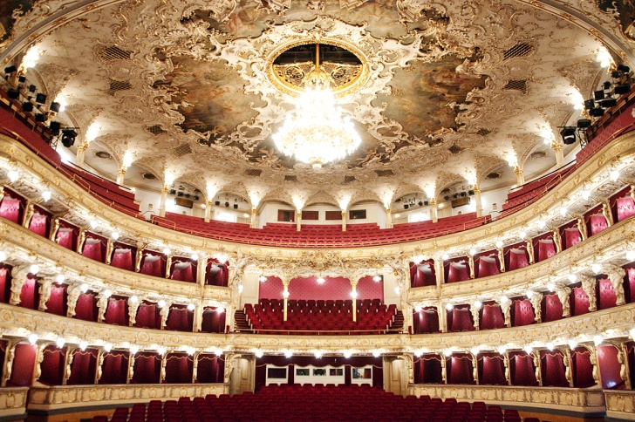
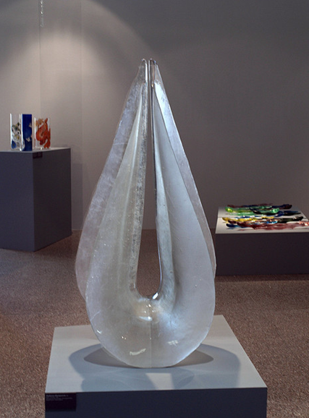
Culture in Prague
Prague is a true cultural treasure trove, bursting with fascinating museums, galleries, theatres, and music venues. The city regularly plays host to numerous prestigious exhibitions, events, and more international festivals .

Slide 18
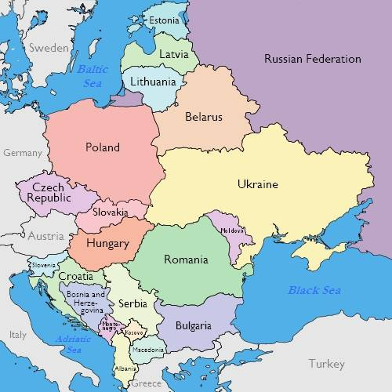

EASTERN EUROPE (CEE)
over 300 mil. inhabitants

Slide 19
Prague is a relatively cheap capital – special invitation to young colleagues from all over the world and colleagues from developing countries
Invitation to attend the congress will be extended to hospital managements, clinicians/medical practitioners and their societies – medical doctors (their nurses) need to learn and appreciate work of the CSSD staff

Slide 20
Simultaneous translation from English to at least Russian, German, Spanish, Portugal
Special invitation for each WFHSS member society in their local language
International PR campaign also on Twitter, Facebook, Instagram and other social networks

Slide 21
Important dates:
On-line abstract submission from December 1st 2013
Abstract submission deadline – May 31 2014
Early bird registration deadline – July 15 2014
Regular registration deadline – September 15 2014

Slide 22

Income of the organising comittee will be used to provide hospital sterilization equippment to the newly constructed remote Fanuel Hospital, Mchinji District in one of the poorest countries in the world - Malawi

Slide 23
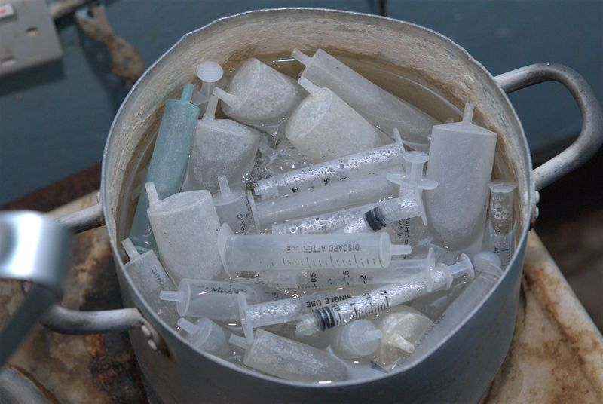
Sterilization in Malawi currently

Slide 24
Why to come to Prague?
■ One of the most beautiful cities in the world,
rich in historical and cultural heritage
■ Easy flight connection worldwide including dozens
of low-cost airlines
■ Safe place in central Europe with warm-hearted
people
■ Excellent standard and affordable services
■ Free public transport for congress participants
■ Close to other beautiful cities and UNESCO sites
Carlsbad, Dresden, Vienna, Bratislava, Krakow

Slide 25
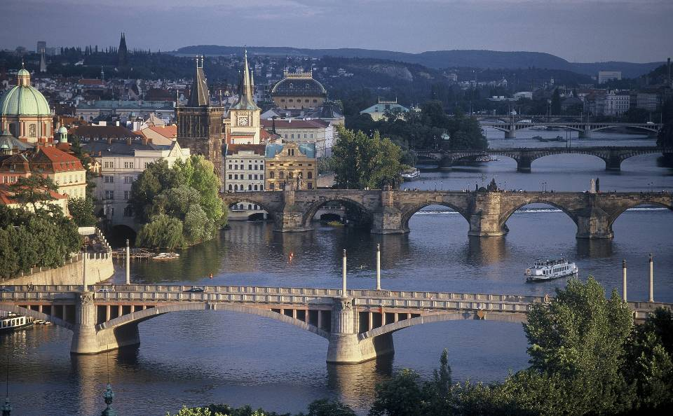
Prague´s Bridges

Slide 26
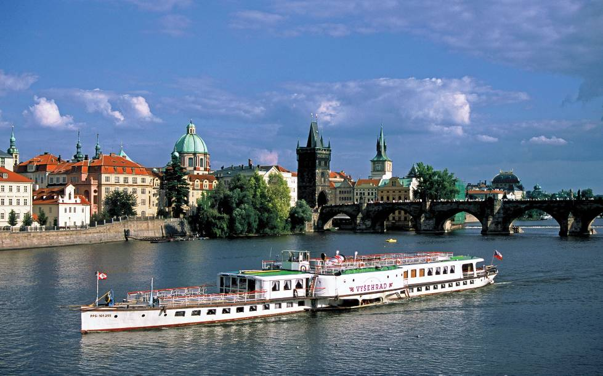
Vltava River

Slide 27
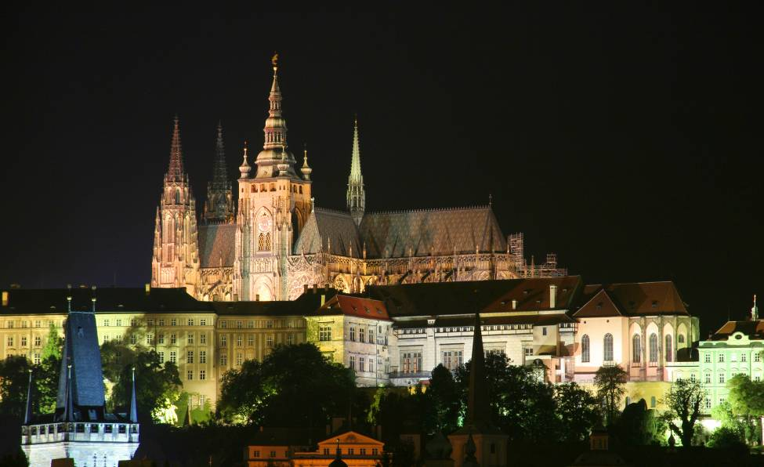
Prague by Night

Slide 28
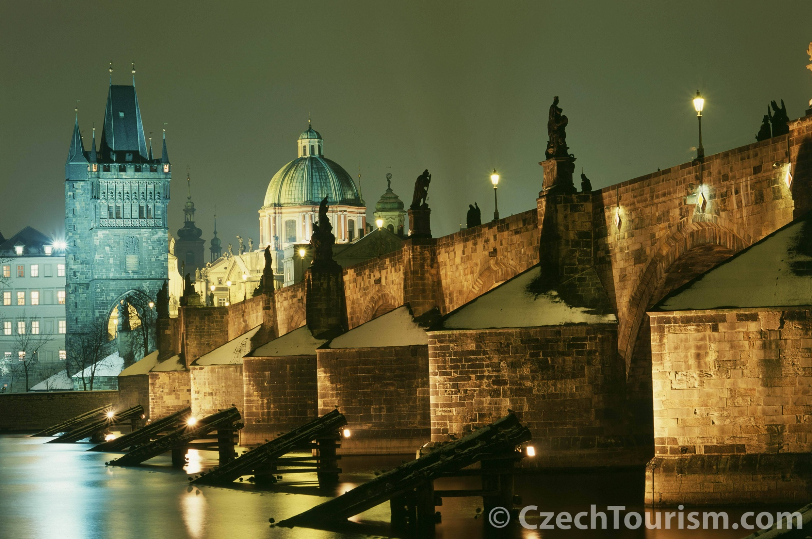
Prague by Night

Slide 29
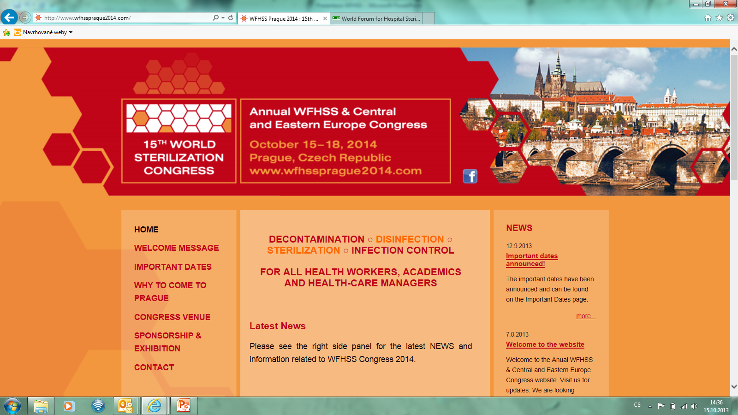


Slide 30

Hope to see you in Prague next year www.wfhssprague2014.com 15.-18. OCTOBER 2014
http://www.youtube.com/watch?v=EzVAMCLYbY0&list=PL694471E8D518FB8D

